Slide 1


CMR TECHNICAL CAMPUS UGC AUTONOMOUS Accredited by NBA & NAAC with ‘A’ Grade Approved by AICTE, New Delhi and JNTU, Hyderabad Kandlakoya(V), Medchal Road, Hyderabad-501401, Telangana Department of Computer Science and Engineering CAMPUS PLACEMENTS PREDICTION & ANALYSIS USING MACHINE LEARNING
BATCH NO : 21
Gaini Vamshi 207R1A0577
K Shiva 217R5A0511
Neeradi KanakaRaju 207R1A05A5
Under the Guidance of
P. Santhuja
(Associate Professor)

Slide 2
CONTENTS
Introduction
Abstract
Existing system
Disadvantages of existing system
Proposed system
Advantages of proposed system
Hardware and software requirements
Novelty
Architecture
Modules
UML Diagrams
Sample code
Results
Conclusion

Slide 3
INTRODUCTION
Placements are considered to be very important for each and every college. The basic success of the college is measured by the campus placement of the students. Every student takes admission to the colleges by seeing the percentage of placements in the college. Hence, in this regard the approach is about the prediction and analyses for the placement necessity in the colleges that helps to build the colleges as well as students to improve their placements .
In Placement Prediction system predicts the probability of a undergrad students getting placed in a company by applying classification algorithms such as Decision tree and Random forest. The main objective of this model is to predict whether the student he/she gets placed or not in campus recruitment. For this the data consider is the academic history of student like overall percentage, backlogs, credits. The algorithms are applied on the previous years data of the students.

Slide 4

ABSTRACT
This project is all about helping college students get jobs. We made a smart system that checks how well students did in their studies and predicts if they will land a job. We used computer programs like Decision Tree and Random Forest to do this job prediction. By looking at past students' data, like grades, backlogs, and credits, we can tell if current students will succeed in getting placed. We compared our smart system with other methods, and it turns out ours is much better at predicting job placements. This is a big deal because good placements make colleges look great and students happy. So, our project helps colleges and students by making better predictions about job success.

Slide 5
EXISTING SYSTEM
The existing system involves multiple studies using machine learning algorithms like Logistic Regression, ID3, and C4.5 to predict student placements in college. These studies achieved varying accuracies, with Logistic Regression reaching 83.33%, ID3 at 82.1%, and C4.5 at 80%. However, existing systems have limitations, such as neglecting relevant attribute selection and missing value handling, which can impact accuracy. The proposed system aims to address these shortcomings for a more robust and accurate prediction of student placements in campus recruitment.

Slide 6
DisadvantageS of Existing System
Lack of Attribute Relevance:
The existing system lacks effective attribute selection, including irrelevant features that may hinder the accuracy of placement predictions.
Missing Value Handling:
A notable disadvantage is the absence of a mechanism to handle missing values in the data, potentially leading to biased predictions and reduced reliability.
Limited Algorithmic Diversity:
The reliance on a narrow set of classification algorithms, without exploring a broader range, limits the system's ability to capture nuanced patterns in student placement data.

Slide 7

Proposed system
In Placement Prediction system predicts the probability of a undergrad students getting placed in a company by applying classification algorithms such as Decision tree and Random forest. The main objective of this model is to predict whether the student he/she gets placed or not in campus recruitment. For this the data consider is the academic history of student like overall percentage, backlogs, credits. The algorithms are applied on the previous years data of the students.

Slide 8
Advantages of proposed system
➢Some of the attributes in the initial dataset that was not pertinent (relevant) to the experiment goal were ignored. The attributes name, roll no, credits, backlogs, whether placed or not, b.tech % ,gender are not used.
The random forest algorithm can also be thought of as an ensemble method in machine learning. The input to a random forest algorithm is a dataset consisting of records, with attributes. Random subsets of the input are created.

Slide 9

Requirements specification
Hardware requirements :
System : Windows
Processor : Pentium IV or higher
Hard disk : 40 GB
RAM : 4 GB
Software requirements :
Operating System : Windows 10
Coding Language : Python
Framework : Django
Designing : HTML, CSS, JavaScript
Data Base : MySQL

Slide 10

NOVELTY
This project introduces advanced user authorization for administrators, enhancing security measures. It incorporates interactive chart representations for predictive analytics on placement datasets, improving visual comprehension of accuracy results. The addition of a remote user module facilitates user registration, login, and personalized operations, contributing to a user-centric experience. Dynamic placement prediction metrics offer real-time insights into accuracy results, prediction types, and placement ratios, enhancing adaptability and responsiveness in predicting student placements.

Slide 11
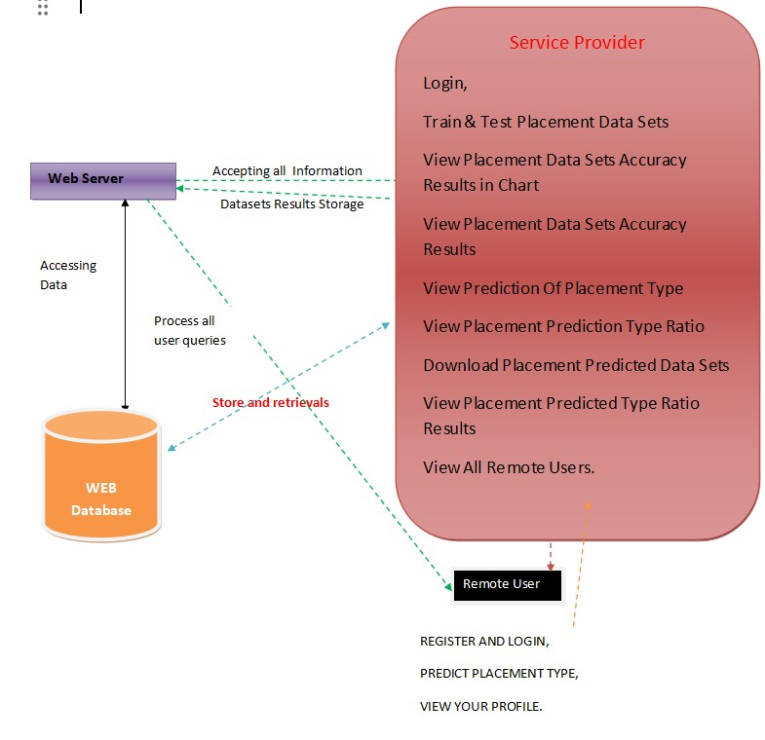
ARCHITECTURE

Slide 12
MODULES
Service Provider:
Service providers log in to perform operations such as training and testing placement datasets, viewing accuracy results, and accessing placement predictions.They can also download predicted datasets, observe placement type ratios, and view information on all remote users.
Remote User:
Users register before utilizing system functionalities, and their details are stored in the database.Upon successful registration, users log in to perform operations like registering and logging in, predicting placement types, and viewing their profiles.

Slide 13
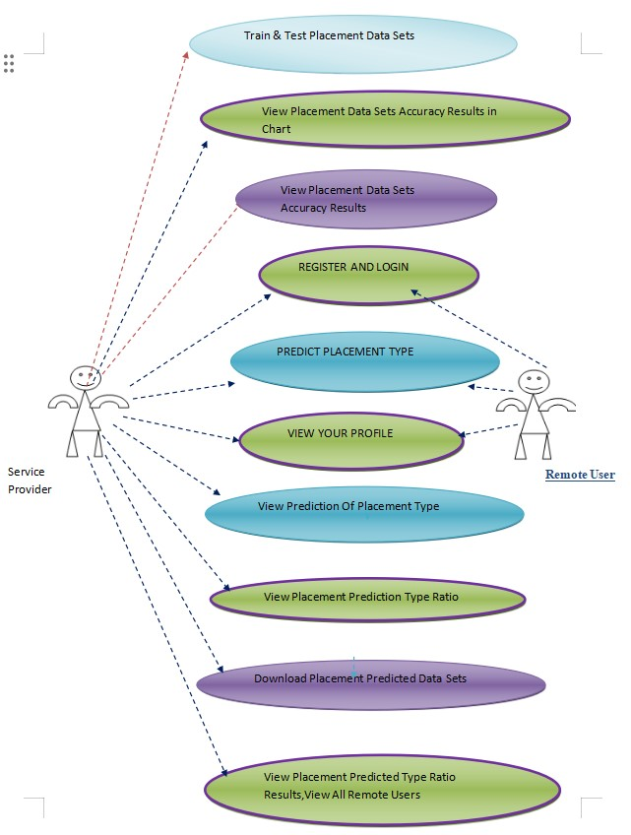
UML DIAGRAMS
USE CASE DIAGRAM

Slide 14
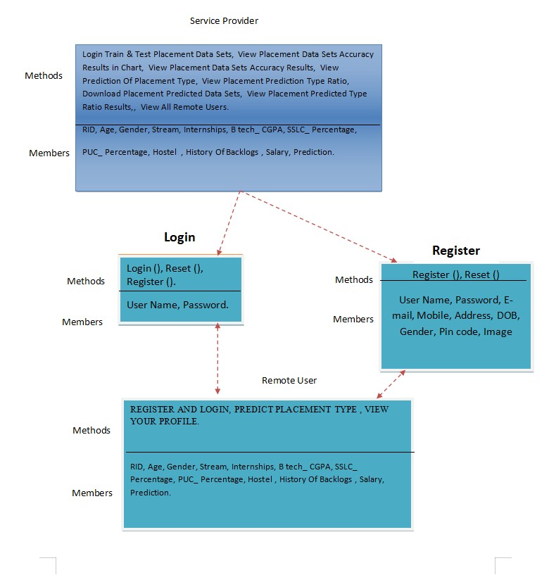
UML DIAGRAMS
CLASS DIAGRAM

Slide 15
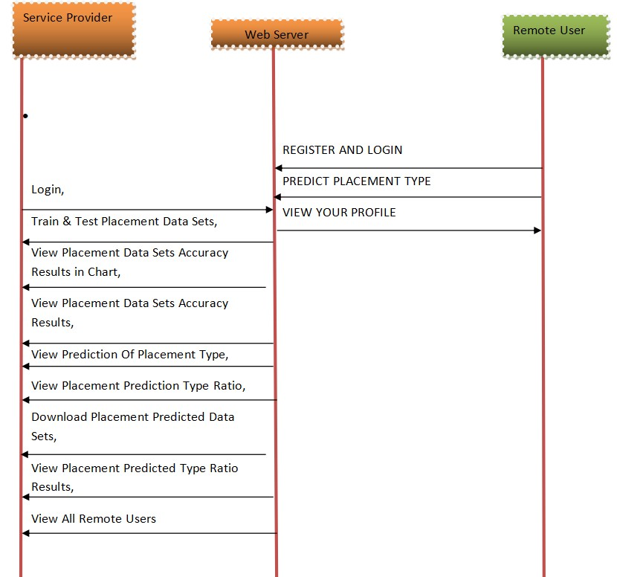
UML DIAGRAMS
SEQUENCE DIAGRAM

Slide 16
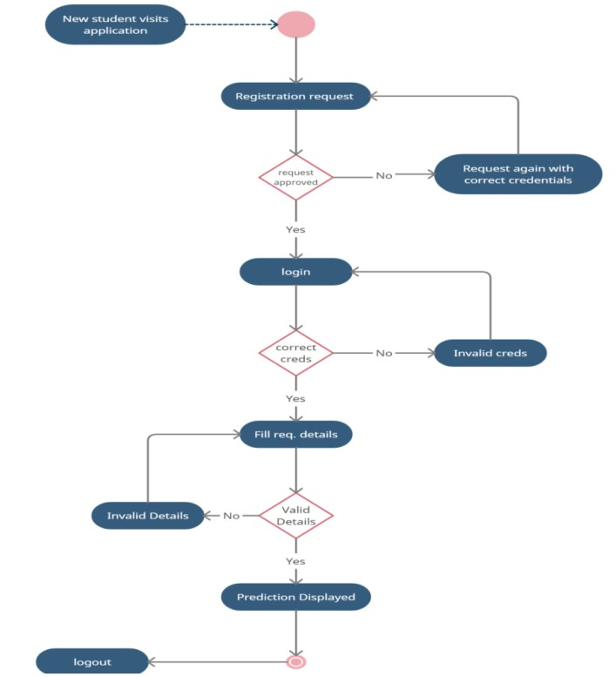
UML DIAGRAMS
ACTIVITY DIAGRAM

Slide 17
SAMPLE CODE
from django.shortcuts import render, redirect, get_object_or_404 from admins.models import Prodcuts
from user.forms import UsersForm, PurchaseForm from user.models import Users, Purchase, Feedback
from user.words import positive_words, negative_words
def home(request):
products=Prodcuts.objects.all()
return render(request,'user/home.html',{'products':products})
def viewproduct(request,pk): pro=Prodcuts.objects.get(id=pk) pros=Prodcuts.objects.get(id=pk) uid=request.session['userid'] uses=get_object_or_404(Users
, id=uid)
if request.method=="POST": form=PurchaseForm(request. POST)

Slide 18
def viewratings(request,pk):
pro = get_object_or_404(Prodcuts, pk=pk) fedbck=Feedback.objects.filter(product=pro)
return render(request,'user/viewratings.html',{'feedbacks':fedbck})
def addratings(request,pk): pos,neg=0,0 sen='pending'
pro = get_object_or_404(Prodcuts, pk=pk)uid = request.session['userid']
uud = Purchase.objects.get(customer=uses,purhased=pro,status='purchased')stat = 'purchased'
except:
stat='not purchased'
if request.method=="POST": ratings=request.POST.get('rating','') comments=request.POST.get('comm ent','')

Slide 19
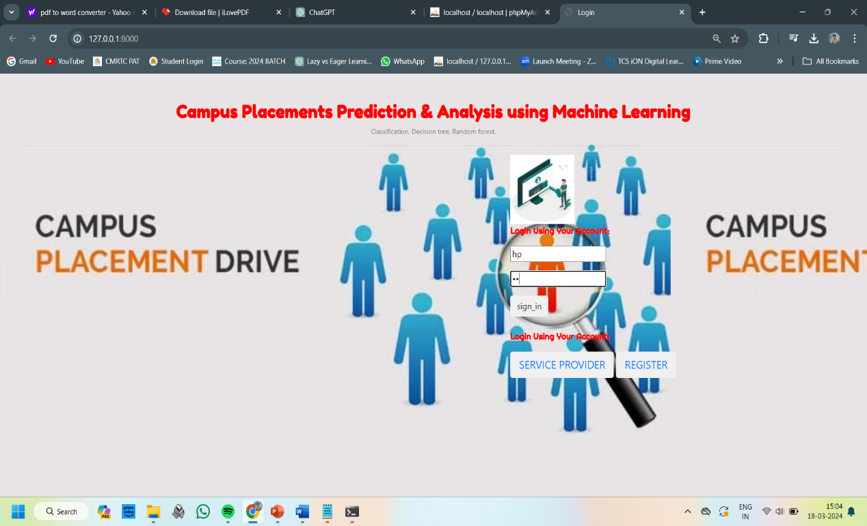
RESULTS

Slide 20
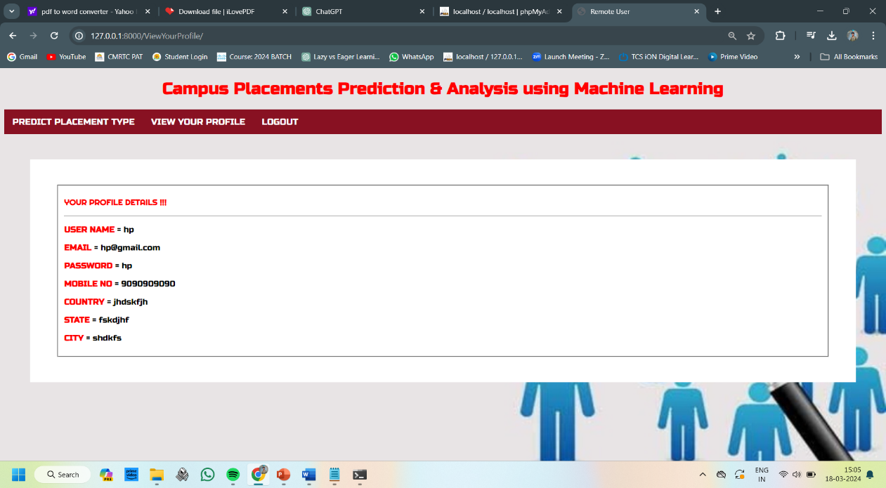

Slide 21
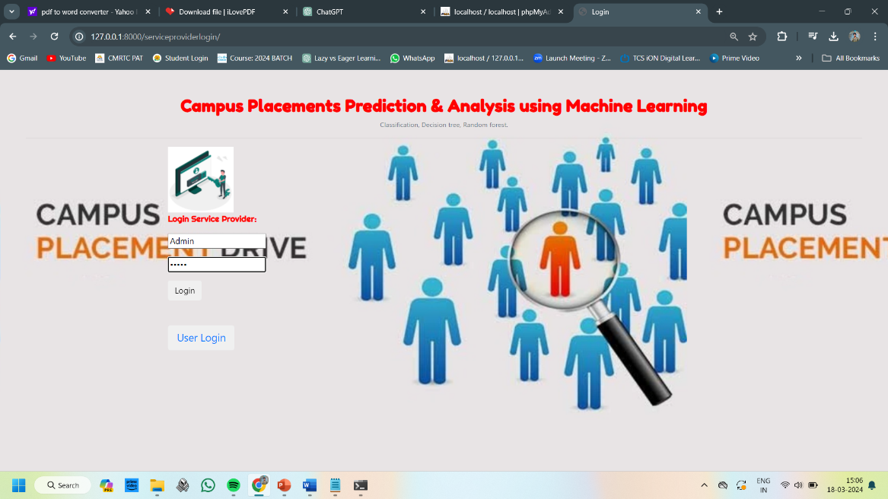

Slide 22
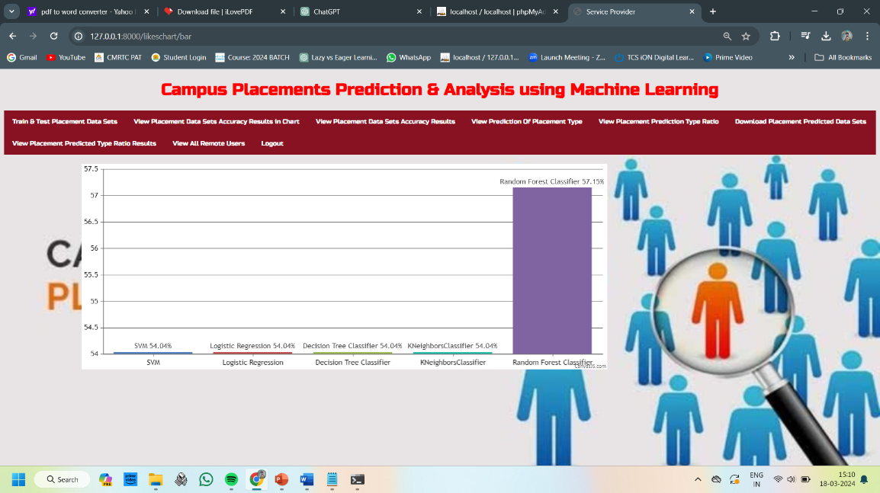

Slide 23
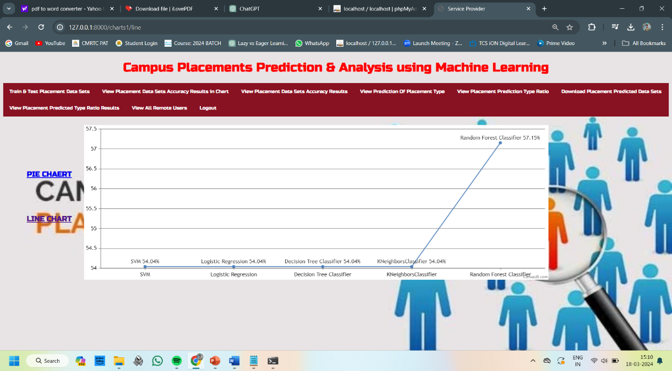

Slide 24
CONCLUSION
The campus placement activity is incredibly a lot of vital as institution point of view as well as student point of view. In this regard to improve the student’s performance, a work has been analyzed and predicted using the classification algorithms Decision Tree and the Random forest algorithm to validate the approaches. The algorithms are applied on the data set and attributes used to build the model. The accuracy obtained after analysis for Decision tree is 84% and for the Random Forest is 86%. Hence, from the above said analysis and prediction it’s better if the Random Forest algorithm is used to predict the placement results.

Slide 25
REFERENCES
[1]Mangasuli Sheetal B, Prof. Savita Bakare “Prediction of Campus Placement Using Data Mining Algorithm- Fuzzy logic and K nearest neighbour” International Journal of Advanced Research in Computer and Communication Engineering Vol. 5, Issue 6, June 2016.
[2]Ajay Shiv Sharma, Swaraj Prince, Shubham Kapoor, Keshav Kumar “PPS-Placement prediction system using logistic regression” IEEE international conference on MOOC,innovation and Technology in Education(MITE), December 2014..
[3]Jai Ruby, Dr. K. David “Predicting the Performance of Students in Higher Education Using Data Mining Classification Algorithms - A Case Study” International Journal for Research in Applied Science & Engineering Technology (IJRASET) Vol. 2,Issue 11,November 2014.
[4]Ankita A Nichat, Dr.Anjali B Raut “Predicting and Analysis of Student Performance Using Decision Tree Technique” International Journal of Innovative Research in Computer and Communication Engineering V0l. 5, Issue 4, April 2017.
[5]Oktariani Nurul Pratiwi “Predicting Student Placement Class using Data Mining” IEEE International Conference 2013

Slide 26
FUTURE SCOPE
The "future scope" of a project refers to the potential avenues for further development, expansion, and advancement beyond its current state. It encompasses the possibilities for growth, innovation, and improvement that could be explored in the future. In the context of a Campus Placements Prediction & Analysis project using Machine Learning, the future scope can be described as follows:
Algorithmic Advancements: Future advancements in machine learning algorithms could lead to the development of more sophisticated models capable of capturing complex patterns in placement data with higher accuracy and efficiency.
Integration of Additional Data Sources: There is potential to incorporate additional data sources such as social media profiles, personality assessments, or industry-specific datasets to enhance the predictive power of the models and provide more comprehensive insights into placement outcomes.
Real-time Prediction and Decision Support: With advancements in technology and computing power, real-time prediction capabilities could be developed, enabling institutions to make timely decisions and interventions to support students in their placement journey.

Slide 27
GITHUB LINK
https://github.com/vamshigaini/Campus-Placement

Slide 28


